Slide 1
SGW Website Options

Slide 2
User Requirements
Maintainable
Ease of Update
Easier way to change text and photos
Easier process to add/remove features
Be able to track Hardman Farm volunteer hrs for the Total Park System hours--
Add “About Us Friends” page w/links to gastateparks.org/smithgallwoods
Add “All Access Trail” page
Add Volunteer data/hours validation feature--

Slide 3
Additional Criteria
Better Site Security
Low to average learning curve
Site Hosting Cost
Code is accessible/portable
Mobile support
Search engine functionality
Form plugins & MySQL support
Twitter feed & blog support?

Slide 4
Application Framework/Tool Decision Matrix
Ratings: Exceptional=5, Good=4, Average=3, Below Average=2, Poor=1
 | PHP / WP | PHP / Joomla! | Wix.com | Composite 1 BlueHost | Composite 2 AWS EC2 | Squarespace
Ease of Update | 5 | 5 | 5 | 3 | 3 | 3
Ease of Maintenance | 3 | 4 | 5 | 4 | 4 | 5
Security Strength | 2 | 4 | 5 | 5 | 5 | 5
Easy to Learn | 3 | 3 | 5 | 4 | 3 | 4
Sum | 13 | 16 | 20 | 16 | 15 | 17
Rank | 6 | 3 | 1 | 4 | 5 | 2
NOTES | 100% UI, 50/50 Custom Code access | 100% UI, Code access | 100% UI, No code access | Full Stack, 100% Coding | Full Stack, 100% Coding | 100% UI, No code access

Slide 5
WordPress vs Joomla!
 | PHP / WP | PHP / Joomla!
Free Themes | 3000+ | 1000+
Free Plugins | 44K | 5K
Hosting Cost | Free - $25 | $30 - $80
Frequency of updates | 40 days | 36 days
Security | Target for hackers and prone to attacks; vulnerabilities in CMS from 3rd party plugins | Uses SSL Certificate on web server
Maintenance | Releases updates that may be incompatible with your site | Uses built-in updater
Mobile Support | Responsive site | Supports various mobile devices
Learning curve | Fairly easy to learn with complex documentation | Fairly easy to learn with detailed documentation

Slide 6
Questions
How much coding are we required to have on our Working System?
What is SGW’s budget for site hosting?
What type of hours should we count from this project for SGW total hours? (team meetings, task assignments, etc.)

Slide 7
Stakeholders
Mr. Art Pease
President, Friends of Smithgall Woods
Dr. Mark Huber
Project Sponsor & Former President, Friends of Smithgall Woods
Mr. Chuck Blaine
Vice President, Friends of Smithgall Woods
Ms. Anne Hughes
Secretary, Friends of Smithgall Woods
Mr. Van Bareither
Treasurer, Friends of Smithgall Woods

Slide 8
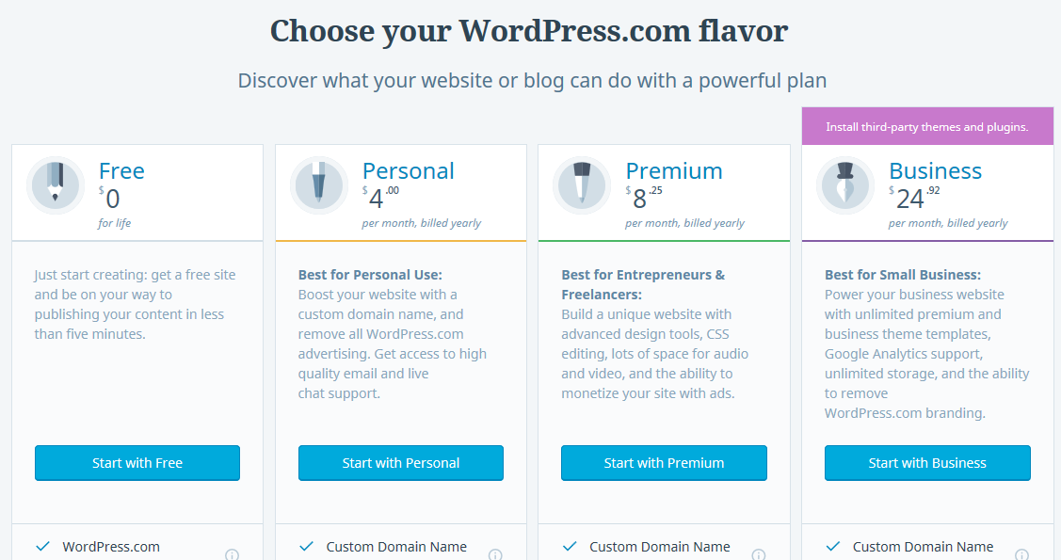
WordPress Site Hosting Price
https://wordpress.com/#plans

Slide 9
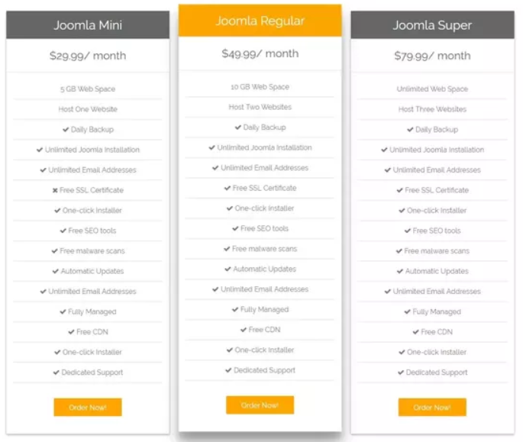
Joomla! Site Hosting Price
https://www.joomla.com/

Slide 10
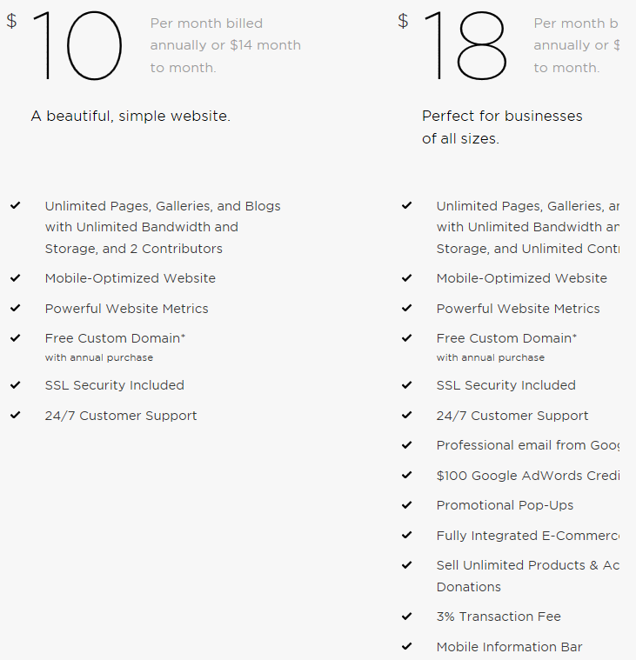
Squarespace CMS & Hosting Price
https://www.squarespace.com/#websites

Slide 11

Site123 CMS & Hosting
https://www.site123.com/faq

